Slide 1
Azure project
MI 462
Joo Yong Yoon

Slide 2
Choice of azure services
Visual Studio (using Python for visualization)
Power BI
Notes:
When I initially set up the learning plan on Microsoft Learn, I chose to learn Python and Power BI. I studied more python courses on Microsoft Learn after I submitted the homework. I thought it helps the both courses I am taking as I am currently learning about visualization using python on cs260. I am not a computer science major so what I have discovered is not near perfect, but I hope I am on the right track using Azure to analyze practical dataset.

Slide 3
Goal
E-Commerce
Using the historical data, understand the effective ecommerce strategy. Make predictions based on the findings.
Indian Market
Analyze Indian cosmetics market. Analyze historical trend & see what affect the net sales the most.

Slide 4
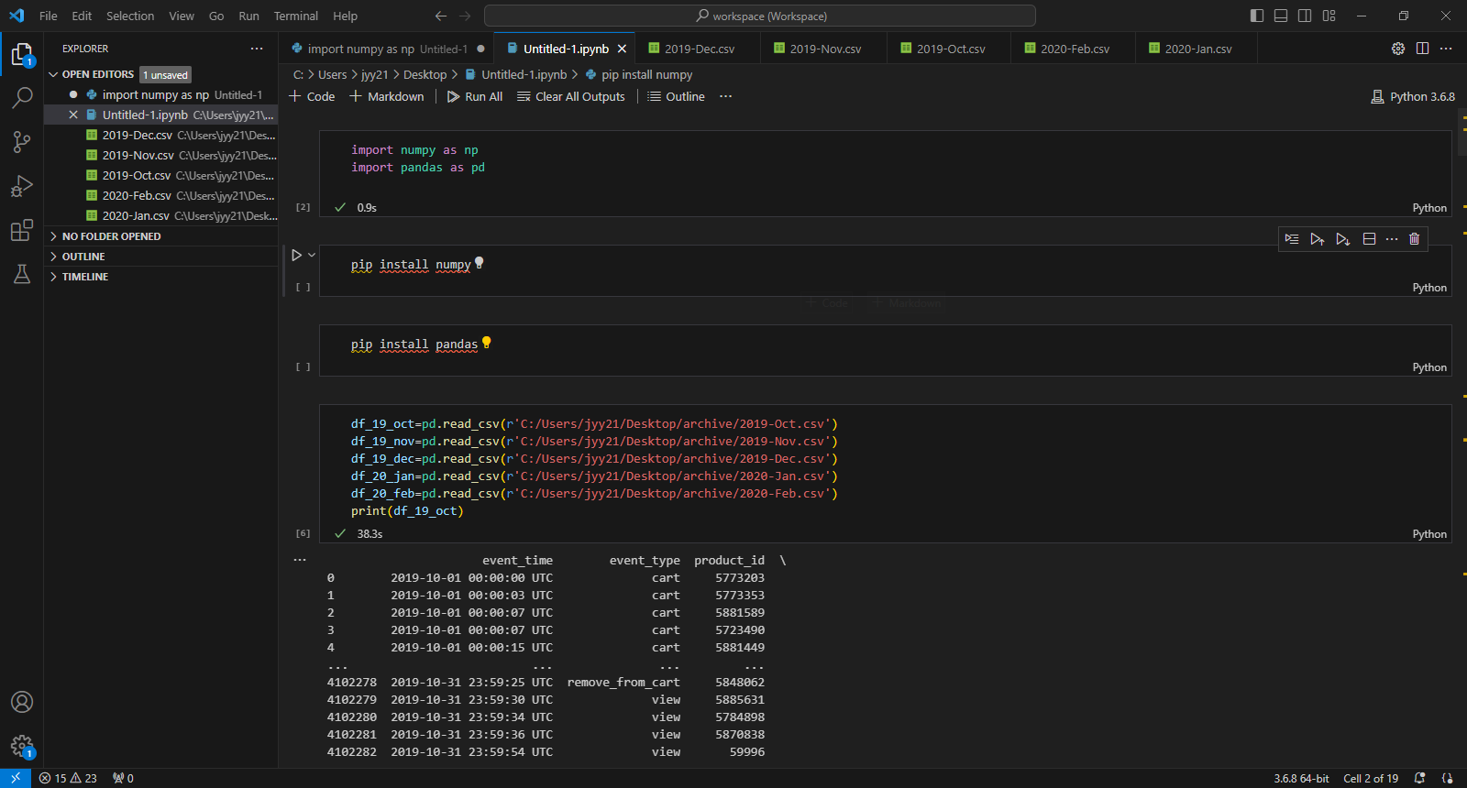
Notes:
Install numpy and pandas. Import cosmetics e-commerce dataset. The biggest difference between this project and other practices from Microsoft learn is that I need to set up the basics from the get-go to clean & process data.

Slide 5
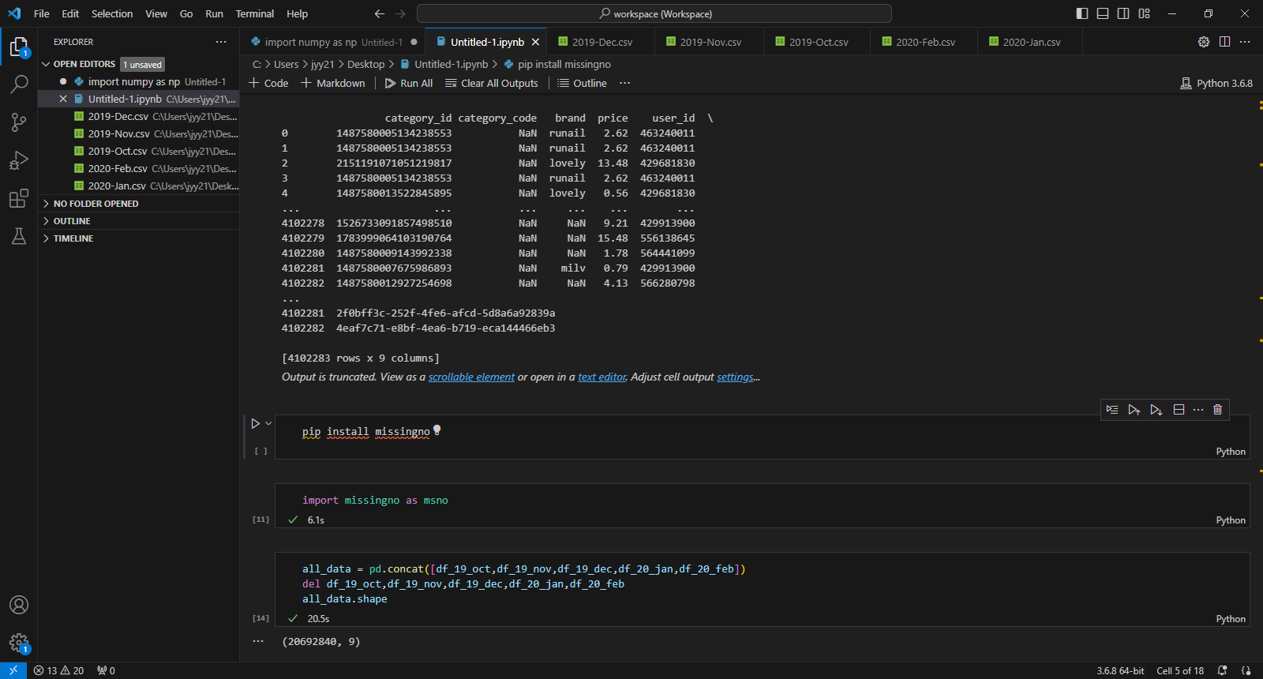
Notes:
Installed missingno. And I concat all the dataset into under one definition: all_data so it is easier to visualize.

Slide 6
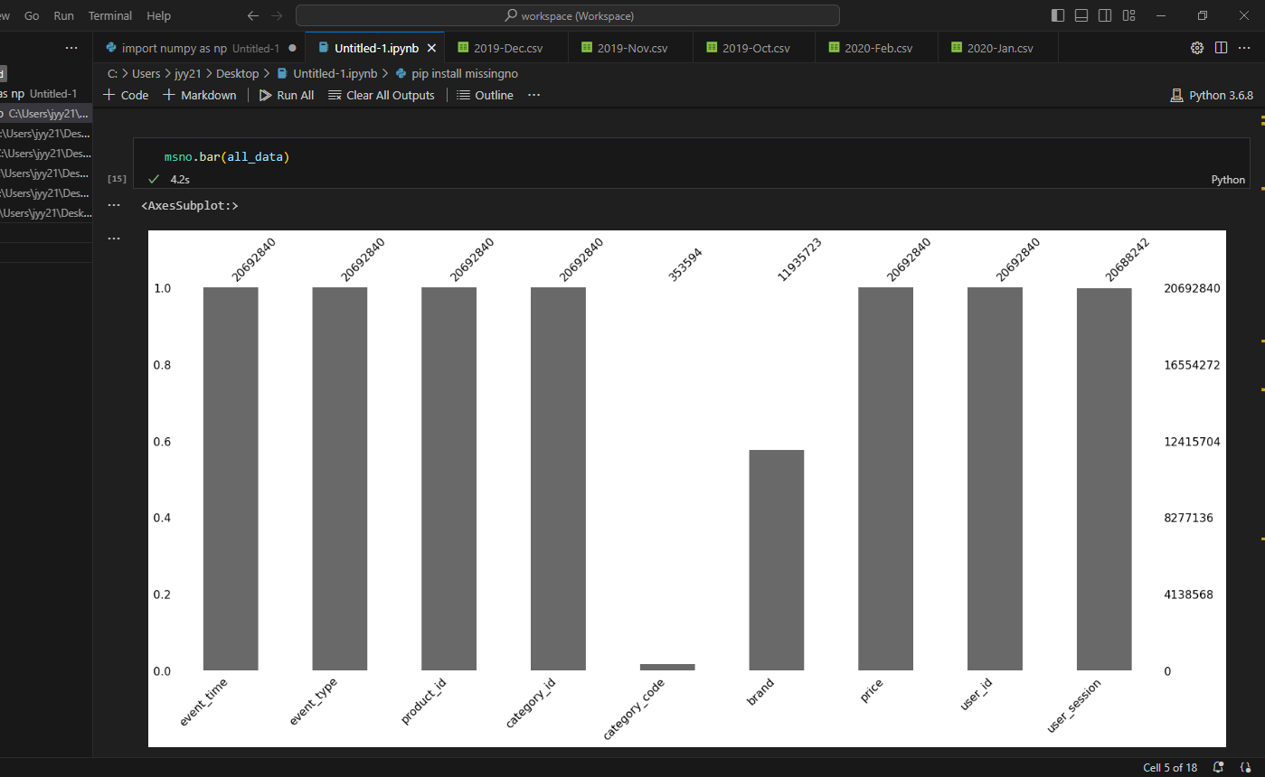
Notes:
I am missing a lot of data from category_code and the brand. And user_session is just a unique value so it is not relevant to my goal. I will drop these data on the next slide.

Slide 7
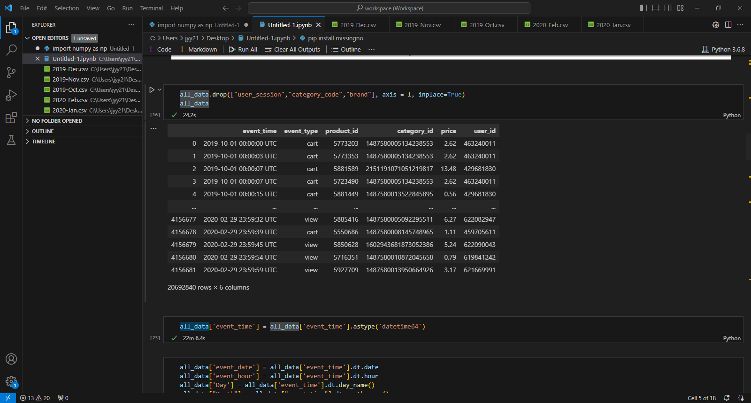
Notes:
Therefore, I dropped these data. And I converted any time information to ‘datetime64’ so pandas can calculate the values. It took me more than 20 minutes to run this. It seems there is ways to make this much faster (I googled the solution, and datetime64 conversion is notoriously slow.) I, unfortunately, could not fully understand the ways to make it faster, so I waited.

Slide 8
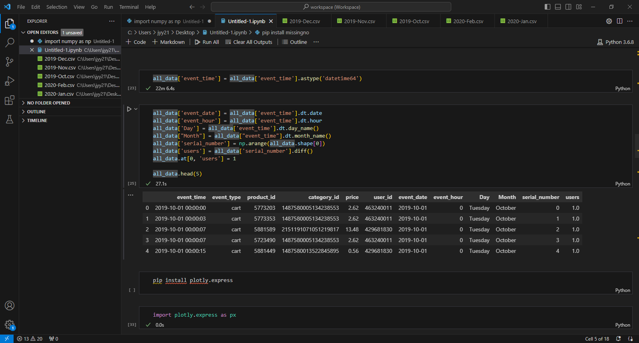
Notes:
Installed plotly.express for visualization. I added/converted 6 new colums to help me with the analysis. I wanted to have a colum that have a value of 1 for all row to do the counting for the qualitative data.

Slide 9
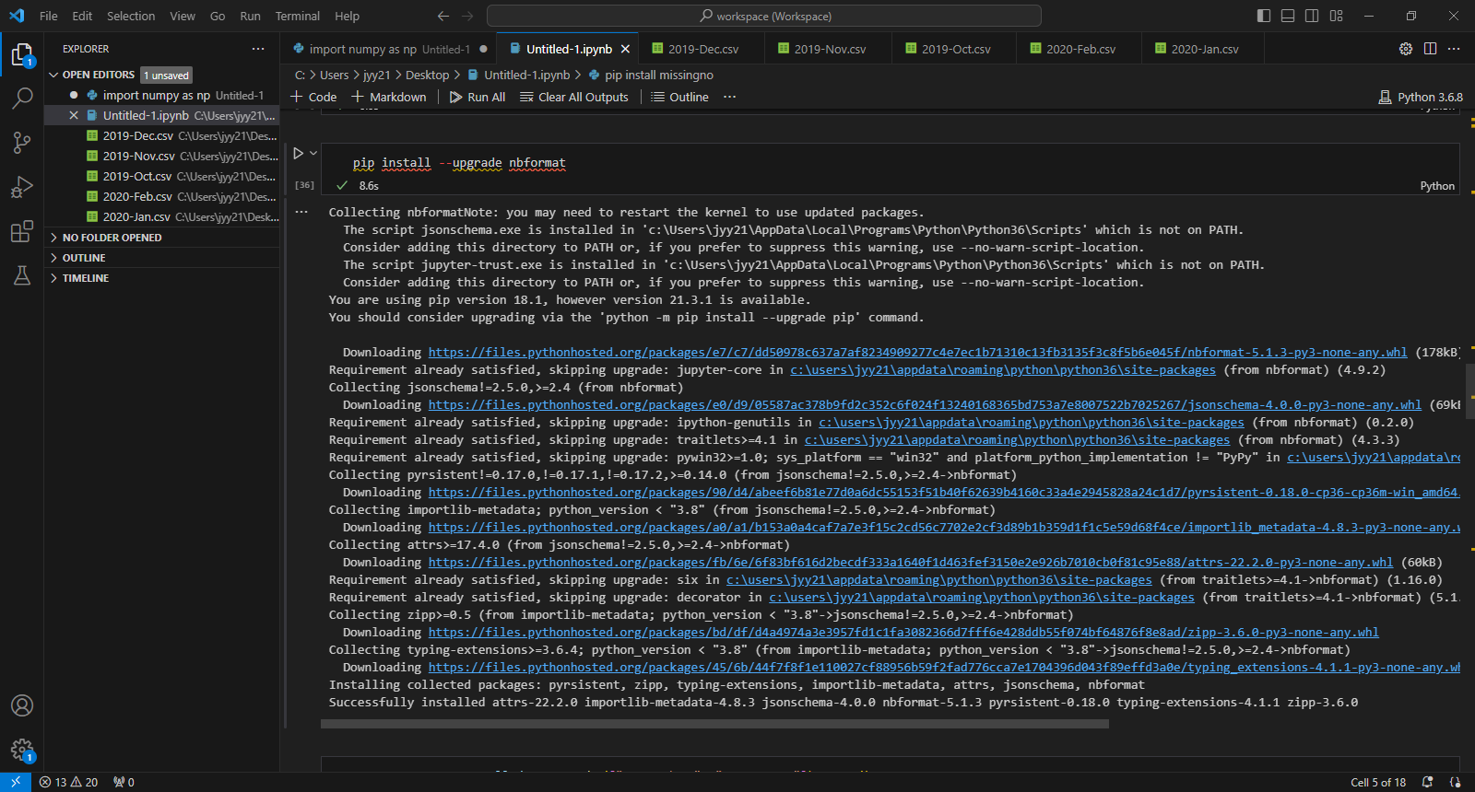
Notes:
This was one of the biggest drawbacks for me. I started to visualize the data and there is an error message coming up. However, it is always followed by the actual graph. So my command generates the visualizations but keeps getting an error. I googled the solution and installing upgrade nbformat seems helpful…..but no luck so far.

Slide 10
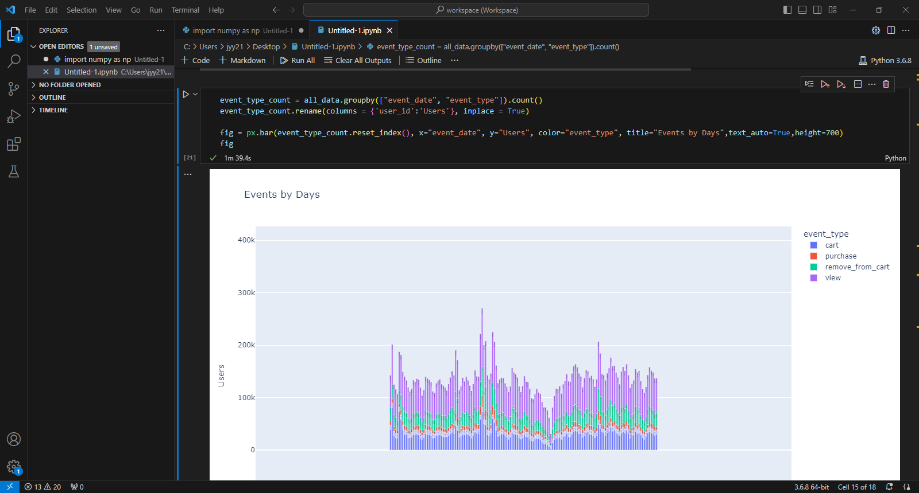
Notes:
This visualization can be useful when it comes to making a strategy. More users browsing/viewing will results in more purchases. Not exact, but there is some clear positive correlation between all 4 events when it comes to # of users viewing. Clear decrease in December til January. I do not have all the information to know the cause, but the research idea can start from here.

Slide 11
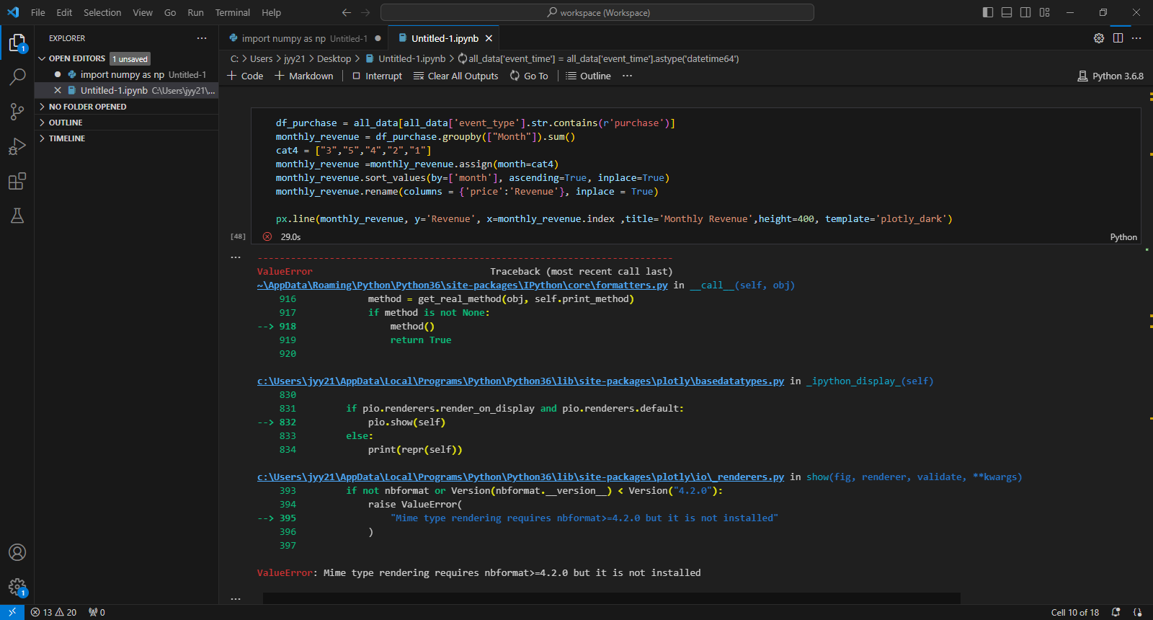
OUR COMPETITION
CONTOSO
COMPETITORS
Our product is priced below that of other companies on the market
Design is simple and easy to use, compared to the complex designs of the competitors
Affordability is the main draw for our consumers to our product
Company A Product is more expensive
Companies B & C Product is expensive and inconvenient to use
Companies D & E Product is affordable, but inconvenient to use
Notes:
Getting error message, but there is a proper visualization below. It will be shown on the next slide.

Slide 12
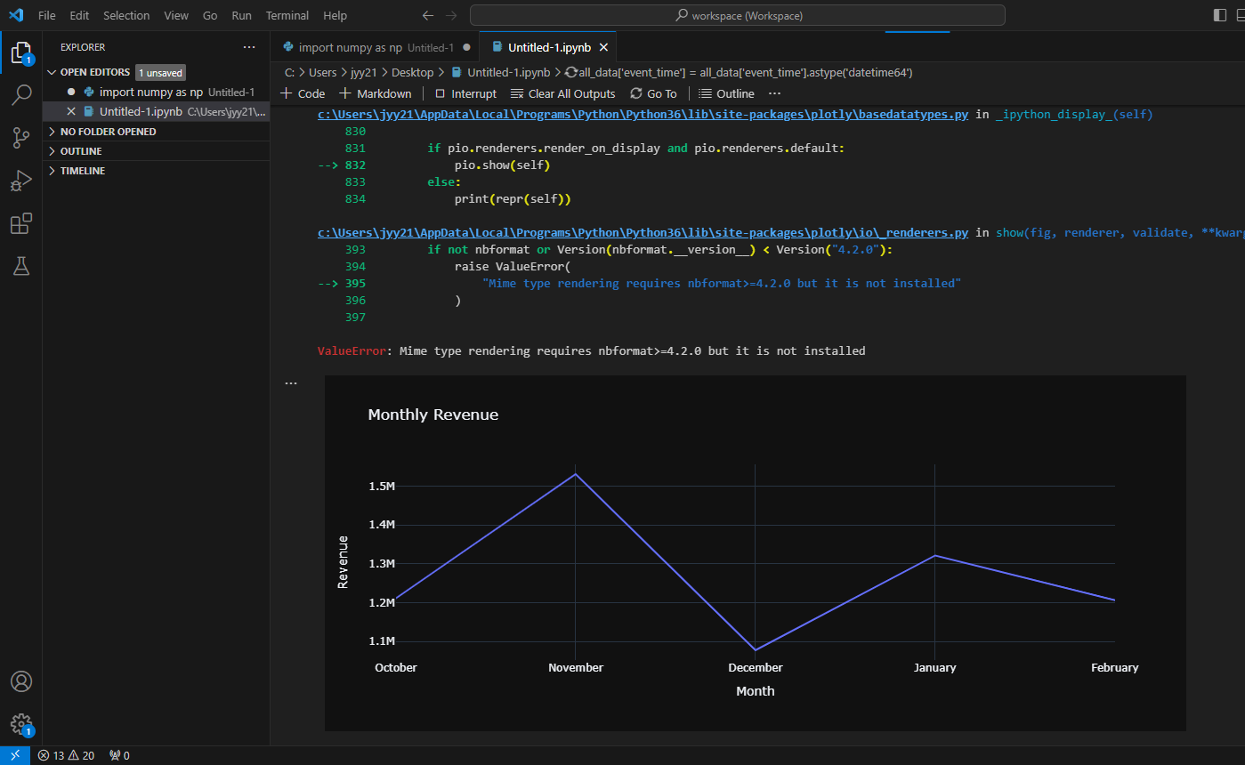
Notes:
With this graph, the best practice is to target November and January. I can suggest some promotional events + new product launching on November and January.

Slide 13
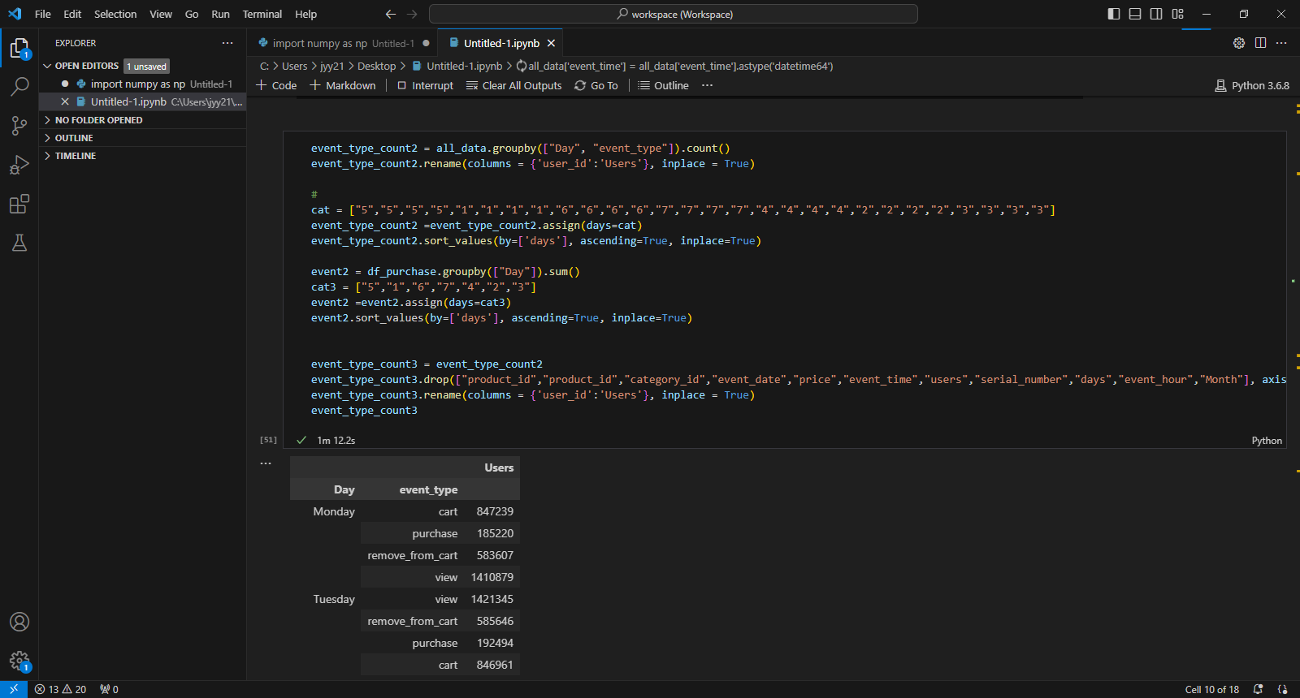
GROWTH STRATEGY
How we’ll scale in the future
PHASE 1: FEB 20XX
Roll out product to high profile or top-level participants to help establish the product
PHASE 2: MAY 20XX
Release of the product to the general public and monitor press release and social media accounts
PHASE 3: OCT 20XX
Gather feedback and adjust product design as necessary
Notes:
This code is to categorize events by days. I cannot really think of the visualization I can do with this so I just ask python to show the data in a table format. The results & analysis will be on the next page.

Slide 14
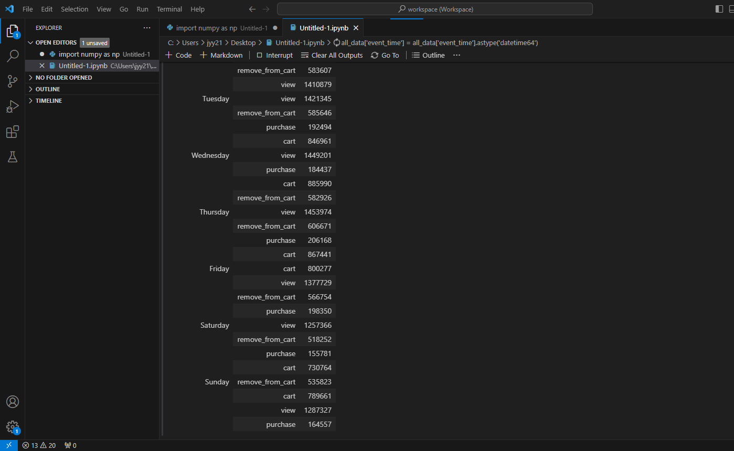
Notes:
The cleaned data shows that there are more traffic during the weekdays than the weekend. This was a bit surprising as I thought more people will shop online during the weekend as they have more free time. The data could suggest that people tend to go outside (could be for shopping) and do the online shopping during the weekdays when they are busy. Also, many customers tend to shop on Thursday and less on Saturdays.

Slide 15
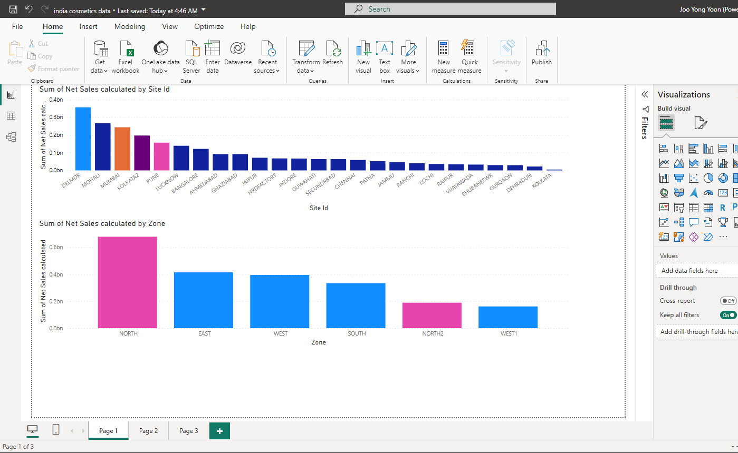
Notes:
The highest sales is recorded at Delmdk. And sales in North and West is recorded more than South and East. I thought it was worthwhile to represent it on the map and check if cash discount affected the net sales.

Slide 16
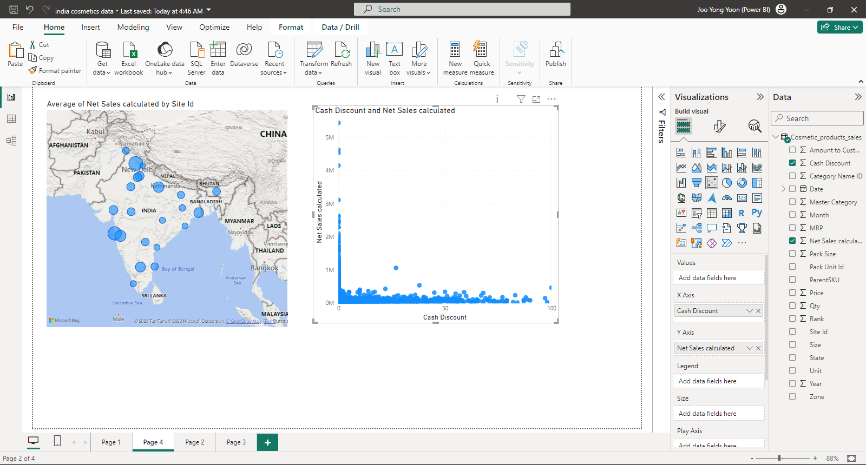
Notes:
The size of the bubble represents the sales volume.
Most of the items are non-discounted or minimally discounted.

Slide 17
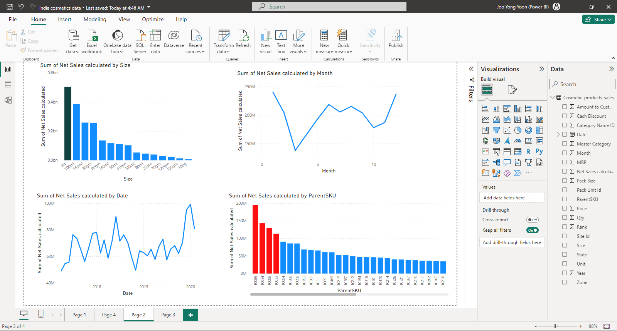
Notes:
Considering the sales size wise, the net sales of 1Kit is the highest followed by 100 ml. So I think it is necessary to design new products in a kit, rather than single packaging. 100ml is the “average” size, and customers do not prefer too large or little volume.
Unlike the data I used for Visual Studio python, the sales in December was pretty high. It is interesting that the sales in January were the highest in the both separate datasheets. I think the reason that the sales of June-Augst and Dec-Jan is high is very closely related to the weather (rainy season + in winters).
There is a decrease in after 2020, but I would argue that overall the sales trend is increasing. Products in ParentSKU F0033, F0034, F0306, F0094, F0098, F0099 and F0089 have greater net sales, the products in these ParentSKU can be promoted in warehouses and zones where there is low sales

Slide 18
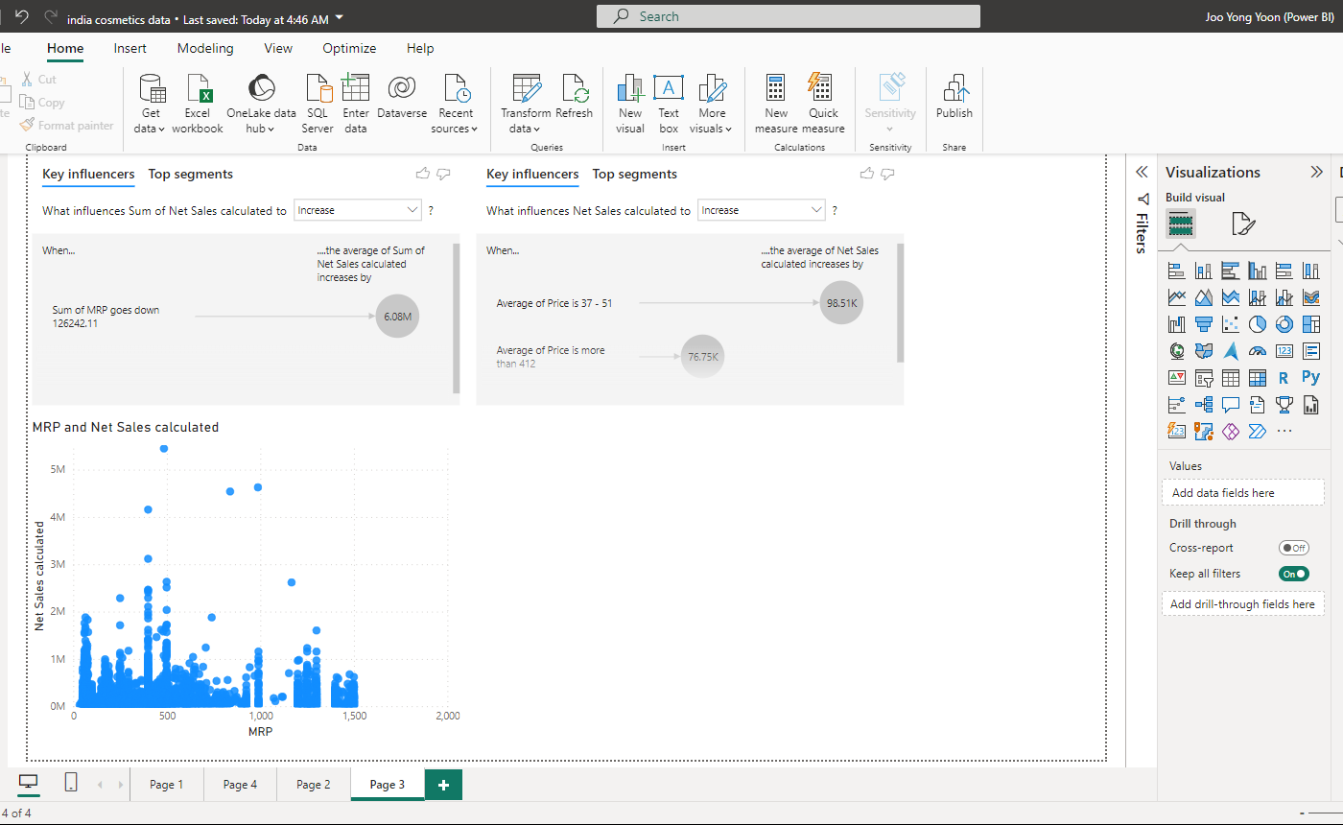
Notes:
I really enjoyed Key influencers analysis. Here, the MRP stands for “Maximum Retail Price”. The both analysis states the $ is the key factor when in comes to the sales volume. I also designed the scatter plot and it shows the same trend. Since $ matters, the company can focus more on cash discounts as no or very less number of products having cash discounts.

Slide 19
THANK YOU

